Slide 1


Implementation of the SBDART model for the estimation of the aerosol radiative forcing
Fernando Londoño Palacio
Tutor: Elena Montilla Rosero
Second Advance
Advanced Project I
Engineering Physics
School of Applied Science and Engineering
Vigilada Mineducación

Slide 2

CONTENT
1
6
Problem definition and objetives
Model check
2
7
First estimations of DARF
SBDART inputs
3
8
Challenges
RT in a plane parallel atmosphere
9
Schedule of actitvities
4
Direct Aerosol Radiative Forcing (DARF – ADRF)
10
Next steps
5
Literature conclusions
11
References
Vigilada Mineducación

Slide 3
3
Problem definition and objetives
Problem?
General: Estimate the radiative forcing due to atmospheric aerosols in the Aburrá Valley by implementing the SBDART model.
Available models to simulate atmospheric radiative transfer:
DART.
libRadtran.
SBDART.
LOWTRAN 7.
Specifics:
Understand the fundamentals of the physical-mathematical model implemented in the SBDART radiative transfer model.
Determine the physical and optical properties of the atmospheric aerosols involved in the SBDART model based on the bibliographic review of the available literature.
Implement the SBDART model using locally available information.
Would the application of the SBDART model considering the optical and physical properties of local aerosols allow us to know the radiative forcing due to these particles in the Aburrá Valley?
Objetives

Slide 4
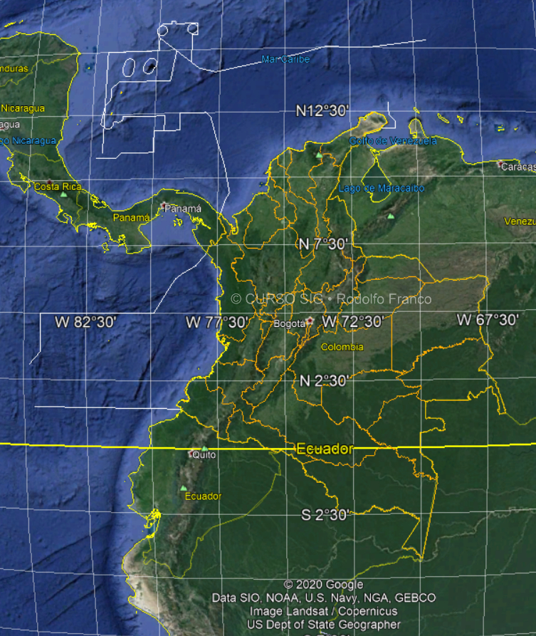
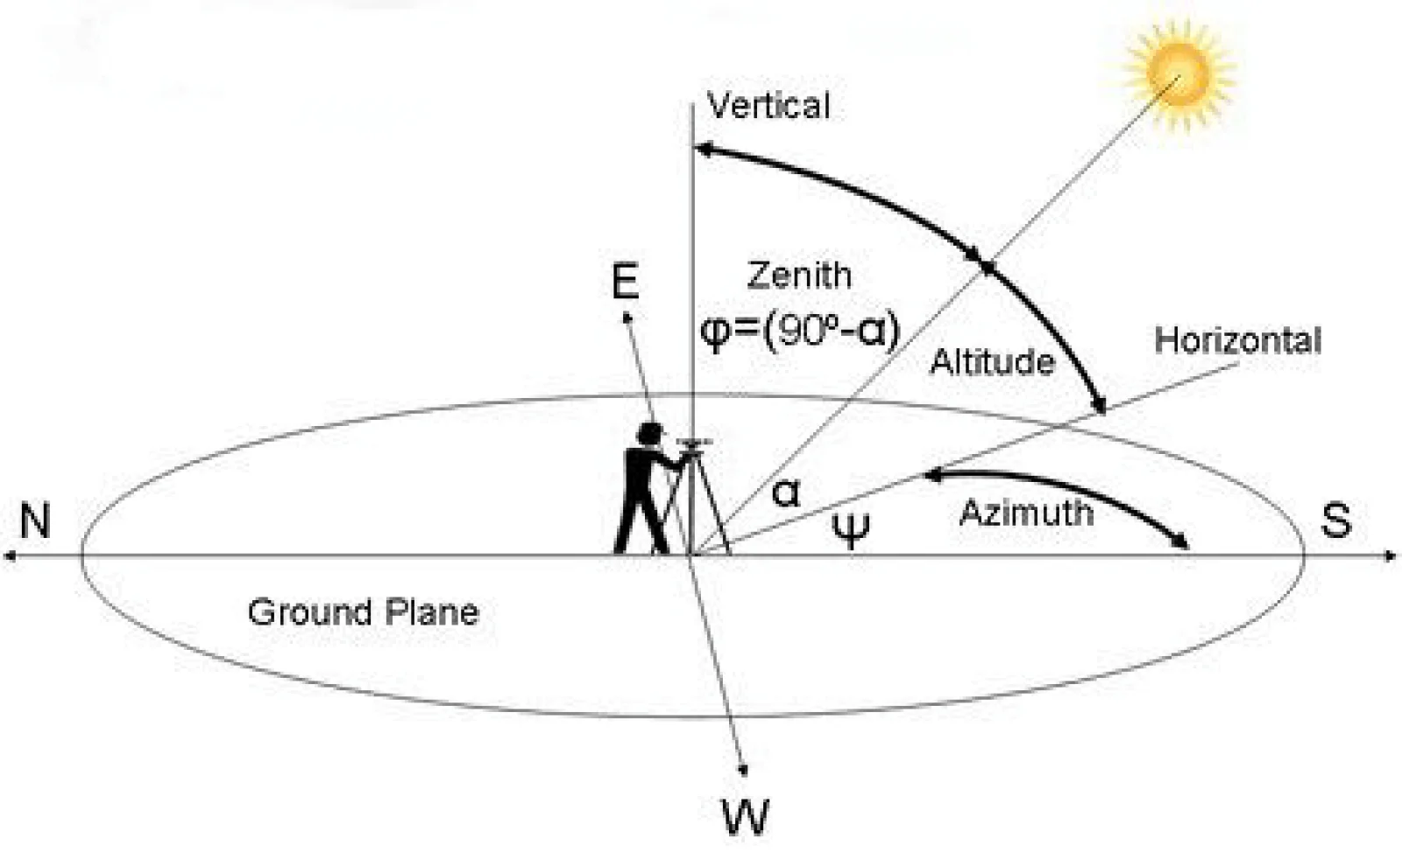
4
SBDART Model
SBDART inputs
Concentrations of gases: O3, NH3, NO2, N2O, CO2, CO, etc.
Meteorology: Temperature, pressure, water amount (UW).
Aerosols: Aerosol Optical Depth (AOD), Single Scattering Albedo (SSA), Asymmetry Factor (g), Angstrom Exponent (AE).
Taken: [1], [2]

Slide 5
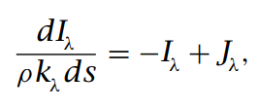
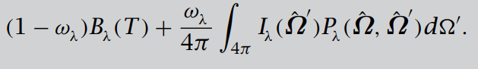
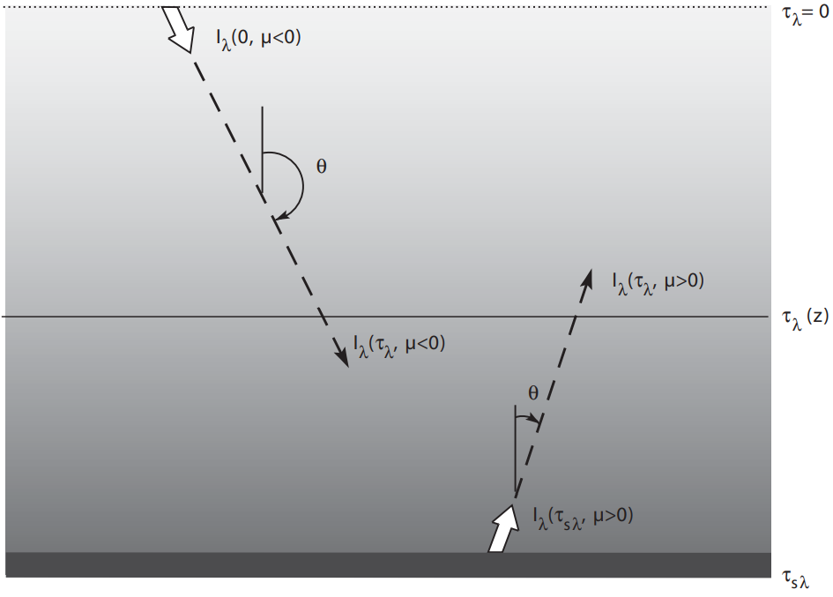
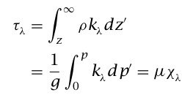
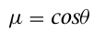
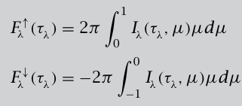
5
RT in a plane parallel atmosphere
General form
Taken: [3]

Slide 6
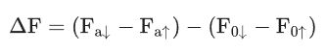
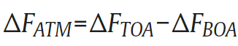
6
Direct Aerosol Radiative Forcing (DARF)
Estimating DARF: The DARF is calculated by taking the differece between fluxes at TOA and SURF and this method accounts the DARF in atmosphere.
Taken: [3], [4]

Slide 7
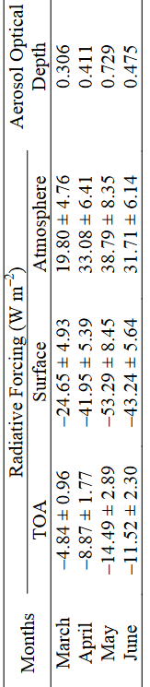
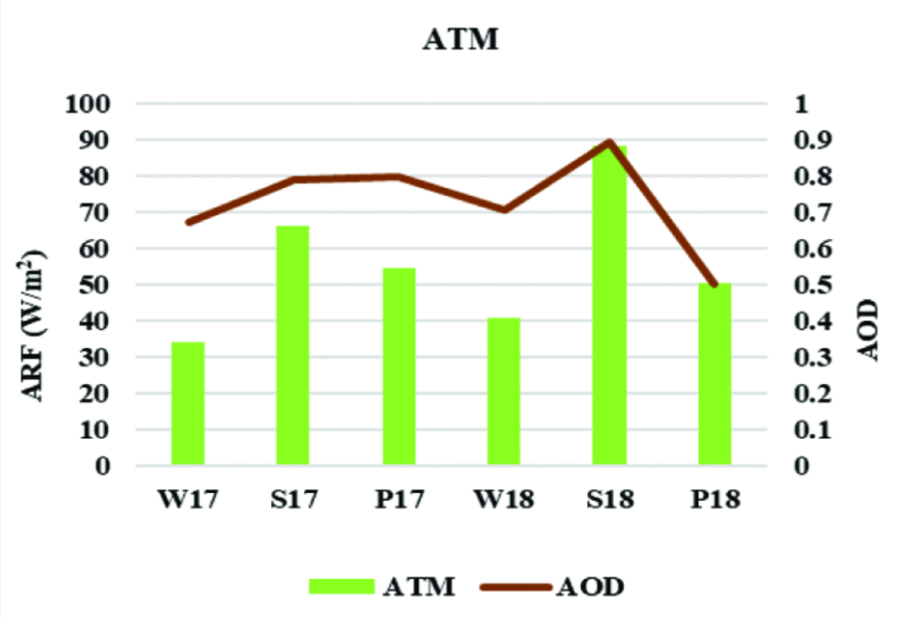
7
Literature conclusions
In order to estimate the DARF, firstly is important to see if varying AOD returns consistent results comparing with other studies; in Gandhinagar and Dehradun, India estimations of DARF showed that AOD is highly correlated with aerosol radiative forcing.
There is a correlation between AOD and ARF, higher values of AOD are associated to higher values of ARF.
Taken: [5], [6]

Slide 8
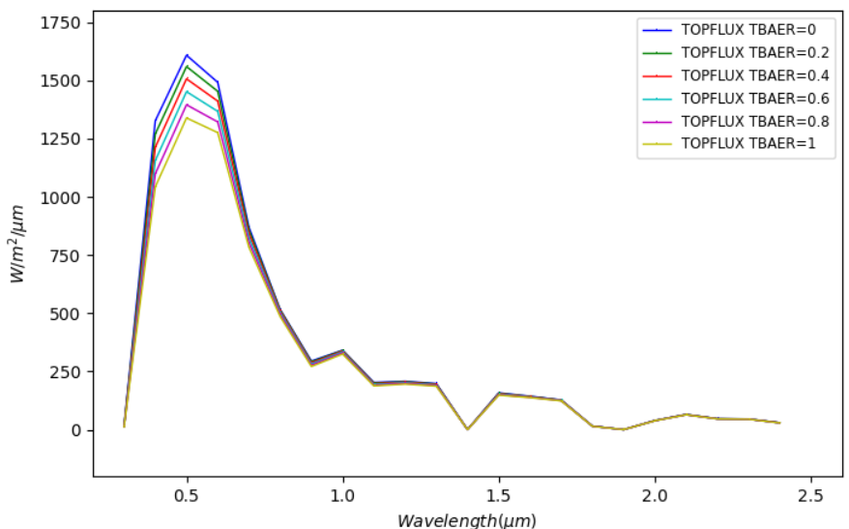
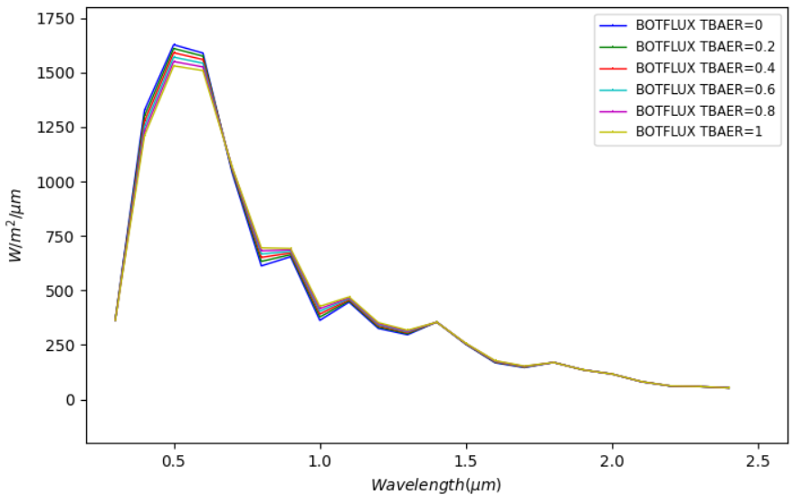
8
Model check
TOA and SURF fluxes varying AOD(550nm) between 0 and 1.

Slide 9
9
Model check
After running the model SBDART changing location and taking the mean daily of DARF values, the model showed to be consistent with the literature.
Taken: [5]

Slide 10
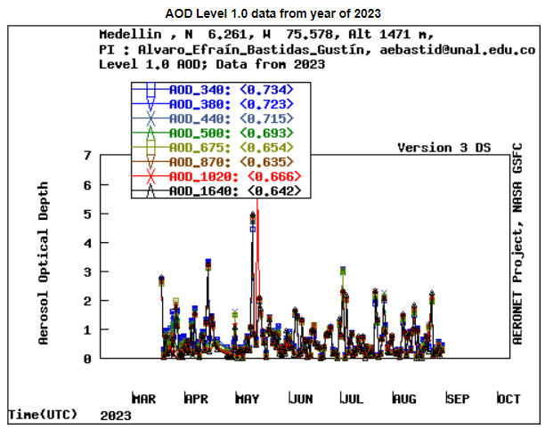
10
First estimations of DARF
Values of AOD for different months in Medellín were taken from NASA AERONET (Aerosol Robotic Network) and values were measured using a CIMEL CE 318 sun photometer.
AOD_500nm (2023) (Data was download and pre-processed):
March: AOD_500 = 0.82
April: AOD_500 = 0.75
June: AOD_500 = 0.59
July: AOD_500 = 0.68
August: AOD_500 = 0.58
Taken: [7]

Slide 11
11
First estimations of DARF
Estimation DARF values for different months:
Taken: [3], [4]

Slide 12
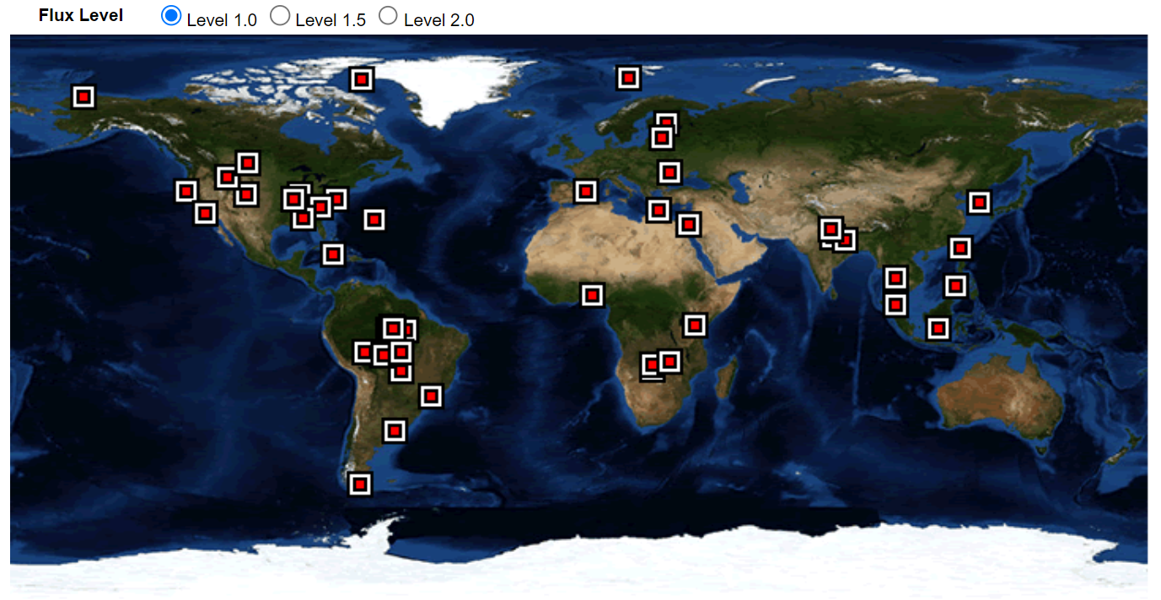
12
Challenges
Values of Single Scattering Albedo (SSA), Asymetry factor (g), Angstrom exponent (AE), clouds, radiative fluxes (TOA – SURF) are not always available.
There are some challenges in values adquisition:
Spatial resolution
Temporal resolution
Spectral resolution
Satellite orbits
Not enough in situ measurements
Taken: [8]

Slide 13
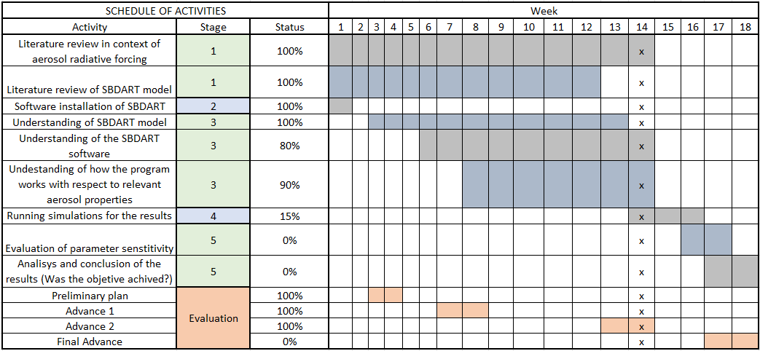
13
Schedule of activities

Slide 14
14
Next steps
Tasks
Estimate DARF considering other relevant optical properties as Single Scattering Albedo (SSA) and asymmetry factor (g).
Identify databases to obtain input parameters for implementing simulations of local radiative transfer.
Create an input file that accounts for local atmospheric properties.
Additional work:
Keep a record of the understanding process of the SBDART model for future developments carried out by the 4DAir programs.

Slide 15
15
References
[1] “Solar geometry - Index of Convalescence.” Index of Convalescence. Accessed: May 2, 2024. [Online]. Available: https://www.of-convalescence.com/entries/solar-geometry
[2] “Coordenadas Geográficas o elipsoidales.” MIXDYR. Accessed: May 2, 2024. [Online]. Available: https://mixdyr.wordpress.com/2020/07/23/coordenadas-geograficas-o-elipsoidales/
[3] Salby, M. L. (2012). Physics of the Atmosphere and Climate. Cambridge University Press.
[4] Z. Shu et al., “Long-term variations in aerosol optical properties, types, and radiative forcing in the Sichuan Basin, Southwest China,” Sci. Total Environ., vol. 807, p. 151490, Feb. 2022, doi: 10.1016/j.scitotenv.2021.151490.
[5] Y. Dahima, T. Turakhia, A. Chhabra, and R. Iyer, “Estimation of Aerosol Radiative Forcing Over an Urban Environment Using Radiative Transfer Model,” in 2020 IEEE India Geoscience and Remote Sensing Symposium (InGARSS), Ahmedabad, India: IEEE, Dec. 2020, pp. 185–188. doi: 10.1109/InGARSS48198.2020.9358932.
[6] P. N. Patel and R. Kumar, “Estimation of Aerosol Characteristics and Radiative Forcing during Dust Events over Dehradun,” Aerosol Air Qual. Res., vol. 15, no. 5, pp. 2082–2093, 2015, doi: 10.4209/aaqr.2015.02.0077.
[7] “AERONET Aerosol Optical Depth Data Display Interface.” Aerosol Robotic Network (AERONET) Homepage. Accessed: May 2, 2024. [Online]. Available: https://aeronet.gsfc.nasa.gov/cgi-bin/data_display_aod_v3
[8] “Solar Radiation Network (SolRad-Net) Data Display Interface - WWW DEMONSTRAT.” Solar Radiation Network (SolRad-Net). Accessed: May 2, 2024. [Online]. Available: https://solrad-net.gsfc.nasa.gov/cgi-bin/type_piece_of_map_flux

Slide 16

THANKS
Vigilada Mineducación

